Slide 1
ITMD 536 Software Testing & Maintenance
Chapter 3 Static Techniques

Slide 2
Objectives
What is Static Testing?
What is Dynamic Testing?
What is Formal Review Process?
What is Software Technical Reviews?
What are different types of review?
What is Informal Review Process?
What are the tools required for Static Analysis?

Slide 3
3. Static Techniques
Helps improve the quality and productivity of software development
Reviews, Requirements, Design, Implementation, Testing and Maintenance
Detects defects earlier in SDLC
Implements automated checks on code

Slide 4
3.1 Static Techniques and the Test Process
The definition of testing outlines objectives that relate to evaluation, revealing defects and quality.
There are two different approaches to achieve it:
Static Testing
Dynamic Testing

Slide 5
3.1 Static Techniques and the Test Process
Static Testing:
Testing of a component or system at specification or implementation level without execution of that software, e.g. reviews or static analysis

Slide 6
3.1 Static Techniques and the Test Process
During static testing, software work products are examined manually, or with a set of tools, but not executed
Advantages of static testing:
Can start earlier in life cycle, feedback on quality can be established early validation of requirements

Slide 7
3.1 Static Techniques and the Test Process
Early detection of defects – will cost low to fix the defects
Development is likely to increase
Evaluation by the team with exchange of information helps between participants
Increase awareness of quality issues

Slide 8
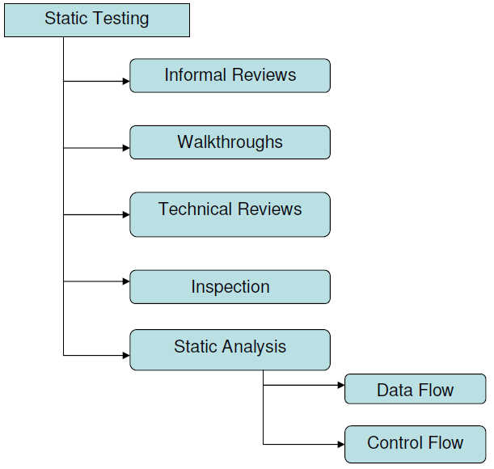

Slide 9
3.1 Static Techniques and the Test Process
Dynamic Analysis: The process of evaluating behavior, e.g. memory performance, CPU usage, of a system or component during execution

Slide 10
3.1 Static Techniques and the Test Process
Dynamic Analysis Tool: A tool that provides run-time information on the state of software code. These tools are most commonly used to identify unassigned pointers, check pointer arithmetic and to monitor the allocation, use and de-allocation of memory and to flag memory leaks.

Slide 11
3.1 Static Techniques and the Test Process
Dynamic Testing: Testing that involves the execution of the software of a component or system

Slide 12
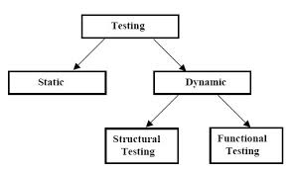

Slide 13
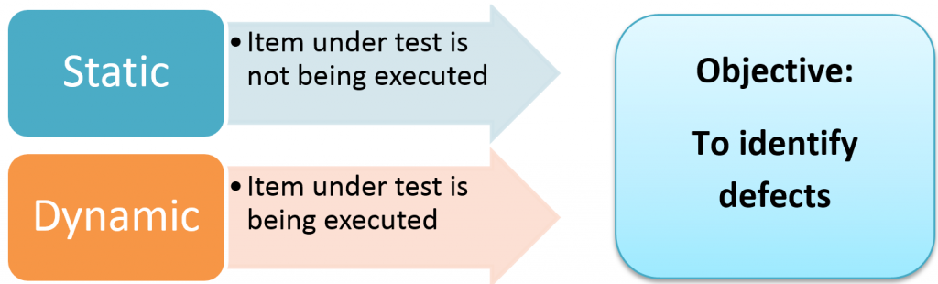

Slide 14
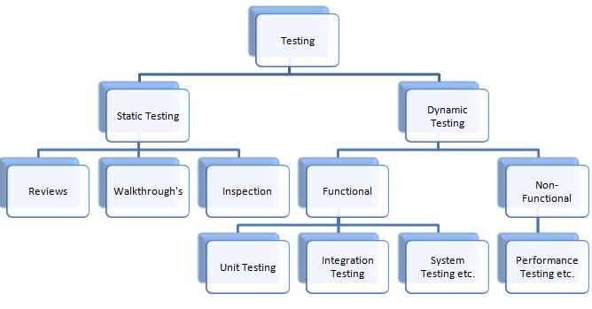

Slide 15
3.2 Review Process
Reviews vary from informal to formal
Informal Review: A review not based on a formal (documented) procedure
Formal Review: A review characterized by documented procedures and requirements , e.g. inspection

Slide 16
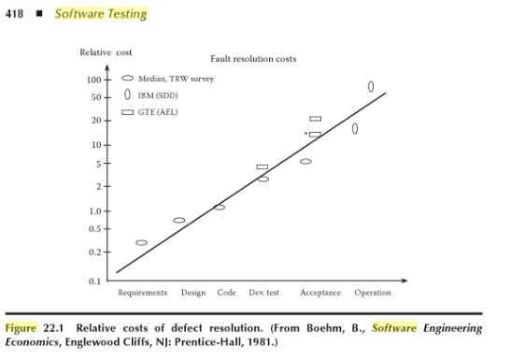

Slide 17
3.2.1 Phases of a formal review
A typical formal review process consist of six steps:
1. Planning
2. Kick-off
3. Preparation
4. Review meeting
5. Rework
6. Follow-up

Slide 18
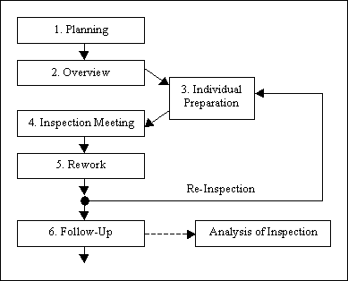

Slide 19
3.2.1 Phases of a formal review
1. Planning:
Define the review criteria
Selecting the personnel
Allocating roles
Define the entry and exit
Selecting which parts of the document to review
Checking entry criteria

Slide 20
1. Planning
Review: A review is requested by the author from the moderator (inspection leaders)
Moderator (inspection leader)
The leader and main person responsible for an inspection or other review process

Slide 21
Entry Criteria (Entry Check)
The set of generic and specific conditions for permitting a process to go forward with a defined task, e.g. test phase. The purpose of entry criteria is to prevent a task from starting which would entail more (wanted) effort compared to the effort needed to remove the failed entry criteria

Slide 22
Entry Check
Document to be reviewed is available with line numbers
Document has been cleaned up by automated checks that apply
References for inspection are stable and available
Author is confident of the quality and is able to join the review team

Slide 23
Reviewer (inspector)
The person involved in the review that identifies and describes anomalies in the product or project under review. Reviewers can be chosen to represent different viewpoints and roles in the review process

Slide 24
Different Roles within a Reviewer
Focus on higher level – does the design comply to the requirement
Focus on standards – consistency, clarity, naming conventions, templates
Focus on related documents – interfaces between software functions
Focus on usage of document – testability or maintainability

Slide 25
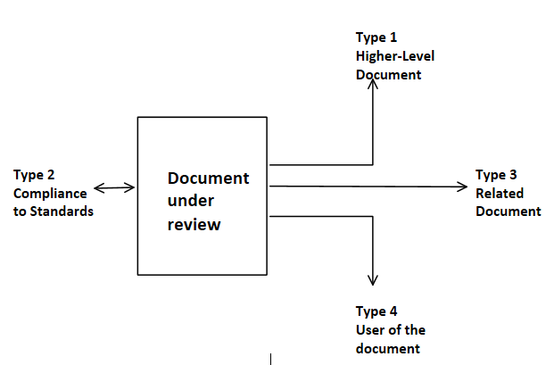

Slide 26
2. Kick-off
Distributing documents
Explaining the objectives, process and documents to the participants
Kick-off meeting is to get everyone on the same page
Reviewers receive a short introduction
Role assignments, checking rate, the pages to be checked, process changes and other questions are discussed

Slide 27


Slide 28
Kick-off
Prepare for the meeting by reviewing the document or documents
Note the defects, questions and comments
Review related documents, procedures, rules and checklists
Use a checklist do document issues
Annotated document will be given back

Slide 29
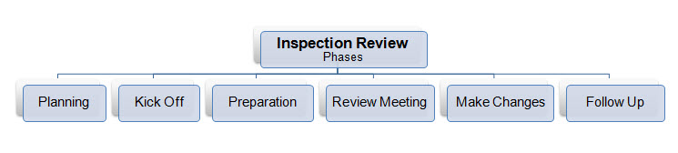
Formal Review Steps

Slide 30
Recording Results from Formal Review
Document results or minutes from formal review meeting
Noting defects, making recommendations and decisions
Examining, evaluating and recording issues during physical meetings or tracking any group electronic communications

Slide 31
Recording Results from Formal Review
Every defect and its severity should be logged
Critical – the scope and impact of the defect is beyond the document under inspection
Major – fault in design can result in an error in the implementation
Minor – non-compliance with standards

Slide 32
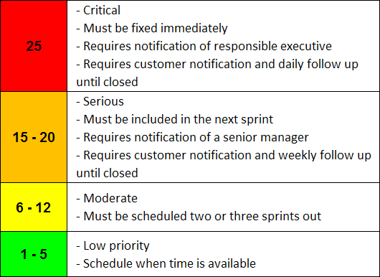

Slide 33
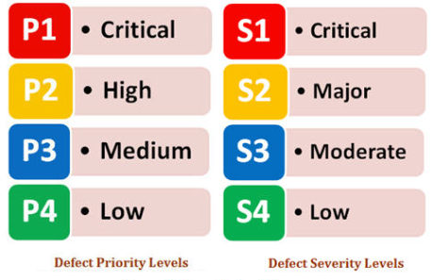
Current Defects Priority and Severity

Slide 34
Rework and Follow-up
Rework:
Fixing defect found
Recording updated status of defects
Follow-up:
Checking the defects have been addressed
Gathering metrics
Checking exit criteria

Slide 35
Metrics
A measurement scale and the method used for measurement
Moderator tracks number of defects found, defects found per page, total review efforts
This information is correct and stored for future analysis

Slide 36


Metrics

Slide 37
3.2.2 Roles and Responsibilities
There are four types of participants in review process:
Moderator
Author
Scribe
Reviewer

Slide 38
3.2.2 Roles and Responsibilities
Moderator: The leader and main person responsible for an inspection or other review process
Performs the entry check and follow-up on the rework.
Schedules meeting, disseminates documents before the meeting leads the discussion and writes the report

Slide 39
3.2.2 Roles and Responsibilities
The Author (Producer): The person who created the document
The author’s task is to illuminate unclear areas and to understand the defects found
The author resolves the action items identified during the review meeting

Slide 40
3.2.2 Roles and Responsibilities
The Scribe (Recorder): The person who records each defect mentioned and any suggestions for process improvement during a review meeting, on a logging form. The scribe should ensure that the logging form is readable and understandable

Slide 41
3.2.2 Roles and Responsibilities
The Scribe (Recorder): Takes notes during the review meeting. The recorded notes will be the basis for the formal review report. Last few minutes go over the notes to see if anything was missed

Slide 42
3.2.2 Roles and Responsibilities
Reviewer (Checkers or Inspectors): The person involved in the review that identifies and describes anomalies in the product or project under review. Reviewers can be chosen to represent different viewpoints and roles in the review process

Slide 43
3.2.2 Roles and Responsibilities
The tasks of reviewers is to check prior to the meeting:
Reviewer Name
Reviewer Preparation Time
A list of issues with severity
An overall review recommendations, standards and checklists (manager decides on execution

Slide 44
3.2.3 Types of Review
There are four types of review:
Walkthrough
Technical Review
Peer Review
Inspection

Slide 45
3.2.3 Types of Review
Walkthrough: A step-by-step presentation by the author of a document in order to gather information and to establish a common understanding of its content.
The content of the document is explained step by step by the author, to reach consensus or to gather information

Slide 46
Walkthrough
To present the document to the stakeholders
To explain and evaluate the contents
To establish the common understanding
To examine and discuss validity and use the proposed alternatives
Scenarios and dry run used to validate

Slide 47
3.2.3 Types of Review
Technical Review: A peer group discussion activity that focuses on the achieving consensus on the technical approach to be taken
During technical reviews defects are found by experts, who focus on the content of the document
Architects, chief designers are included

Slide 48
Technical Review
A documented inspection process
Formal review training
Establish consistency
Budget review and preparation
Sufficient lead time
Checklist
“Buy in” by everyone

Slide 49
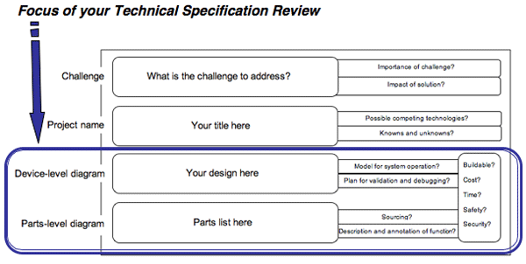

Slide 50
3.2.3 Types of Review
Peer Review: A review of a software work product by colleagues of the producer of the product for the purpose of identifying defects and improvements. Examples are inspection, technical review and walkthrough

Slide 51
Peer Review
Key characteristics of technical review are:
Documented defect-detection process that involves peers and technical experts
Lead by trained moderator
Formal checklist are optional

Slide 52
3.2.3 Types of Review
Inspection (Audits): A type of peer review that relies on visual examination of documents to detect defects, e.g. violations of development standards and non-conformance to higher level documentation. The most formal review technique and therefore always based on a documented procedure

Slide 53
Inspection (Audits)
Inspection (Audit) is the most formal review type
Usually conducted by the software quality assurance group
Help the author to improve
Remove defects efficiently as early as possible

Slide 54
Inspection (Audits)
Improve product quality
Create common understanding
Train new employees
Learn from defects
Rules and checklists are used
Metrics are gathered and analyzed to optimize the process

Slide 55
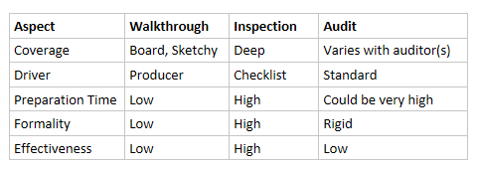
Comparison of Review Types
Walkthrough
Inspection
Audit

Slide 56
Contents of an Inspection Packet
Work Product Requirements – what/how cycles are set for technical inspection – verify how part is accomplished.
Frozen Work Product – each member receives full inspection packet.

Slide 57
Contents of an Inspection Packet
Standards and Checklists – identifies the kinds of problems that a reviewer should look for.
Review Issues Spreadsheet – Individual reviewers identifies issues and submit them to the review leader.

Slide 58
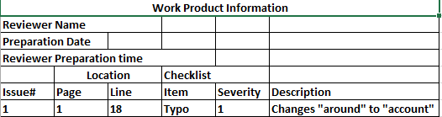
Review Issues Spreadsheet

Slide 59
Review Reporting Forms
Individual reviewers complete and submit their individual reports to the review leader.
Reviewer leader combines all the reviews and lists:
Showstopper issues
OK as is, minor or major rework needed

Slide 60
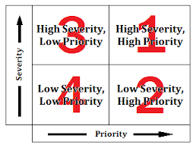
Fault Severity Levels Priority/Severity

Slide 61
Review Report Outline
1. Introduction
Work product identification
Review team members and roles
2. Preliminary issue list
Potential fault
Severity
3. Prioritized action item list
Identified faults
Severity

Slide 62
Review Report Outline
4. Summary of individual reports
5. Review statics
Total hours spent
Faults sorted by severity
Faults sorted by location
Review recommendations
Appendix with the full review packet

Slide 63
3.2.4 Success Factors for Reviews
Here are the critical success factors:
Find a “Champion”
Pick things that really count
Pick the right technique
Explicitly plan and track review activities
Train participants

Slide 64
3.2.4 Success Factors for Reviews
Manage people issues
Follow the rules but keep it simple
Continuously improve process and tools
Report results
User testers
Just do it

Slide 65
Find a ‘Champion’
Champion has expertise, enthusiasm and a practical mindset in order to guide moderators and participants.
Authority should be clear and management support is essential for success.
Schedule adequate time for review.

Slide 66
Pick things that really count
Select documents that are highly important.
Review highly critical requirements.
The invested hours will have a clear and high return on investment.

Slide 67
Pick the right techniques
Consider the type, importance, and risk level of the work product to be reviewed, and the reviewers who will participate.
Make sure each review has a clear objective and the correct type of review is selected that matches the defined objective.

Slide 68
Explicitly plan and tack review activities
Review hours should be tracked and made visible.
Tracking hours will improve planning for the next review.
Management plays and important part in planning of review activities.

Slide 69
Train participants
Training participants is crucial for the success of the project.
Special training should be provided to the moderators to prepare them for their critical role in the review process.

Slide 70
Manage people issues
Reviews are about evaluating someone’s document.
People issues and psychological aspects should be handled tactfully by the moderator.
Defects should be welcomed and expressed objectively.
Work and operate in trusted atmosphere

Slide 71
Follow the rules but keep it simple
Make the process only as formal as the project culture or maturity level allows.
Do not become too theoretical or too detailed.
Checklists and roles are recommended to increase effectiveness of defect identification.

Slide 72
Continuously improve process and tools
Checklist based upon the ideas of participants, ensures the motivation of the developers/engineers.
Motivation is the key to a successful change process.
Emphasis on continuous learning and process improvement

Slide 73
Report results
Report quantified results and benefits to all those who are involved.
Discuss the consequences of defects if they had not been found this early.
Costs should be tracked.
Quantify the benefits of the costs.

Slide 74
User testers
Users provide valuable input to the review.
Testers who participate in reviews learn about the product.

Slide 75
Just do it!
The process is simple but not easy.
Every step of the process is clear, but experience is needed to execute them correctly.
Get the experience people on board to help where possible.
Start doing reviews and start learning from every review.

Slide 76
3.3 Static Analysis by Tools
Static analysis – Analysis of software artifacts, e.g. requirements or code, carried out without execution of these software development artifacts. Static analysis is usually carried out by means of a supporting tool.

Slide 77
Static Analysis
Performed on requirements, design or code without actually executing the software.
Ideally performed before the types of formal review.
The goal is to find defects.

Slide 78
Static Analysis Tools
Static analysis tools are typically used by the developers before, and sometimes during component and integration testing and by designers during software modeling.
Compiler is a static analysis tool check for non-compliance to code language convention (syntax).

Slide 79
Compiler
Compiler: A software tool that translates programs expressed in a high order language into their machine language equivalents.

Slide 80
Defects – during static analysis of code
Referencing a variable with a undefined value.
Inconsistent interfaces between modules and components, such as wrong parameters etc.
Improper declaration of variables or the declaration of variables that are never used.

Slide 81
Defects – during static analysis of code
Unreachable (‘dead’) code that can safely be removed.
Missing or erroneous logic or infinite loop.
Highly complex functions.
Standards violations – risks and failures.
Security vulnerabilities.
Syntax violations of code and software models.

Slide 82
3.3.1 Coding Standards
Coding standard consists of a set of programming rules (check boundaries when copying an array)

Slide 83
3.3.2 Code Metrics
Experienced programmers know that 20% of the code will cause 80% of the problems.
Complexity analysis helps to find all-important 20%, which relates back to the principle of defect clustering.

Slide 84
Complexity
Complexity – The degree to which a component or system has a design and/or internal structure that is difficult to understand, maintain and verify.

Slide 85
Cyclomatic Complexity
The number of independent paths through a program. Cyclomatic complexity is defined as:
L=N+2P, where
- L = the number of edges/links in a graph
- N = the number of nodes in a graph
+ P = the number of disconnected parts of the graph(called graph or subroutine).

Slide 86
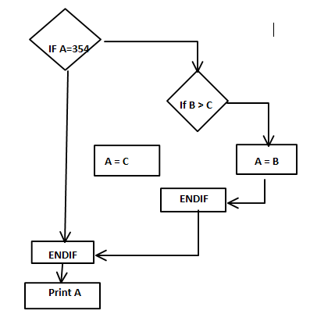
Control Flow of a Simple Program

Slide 87
3.3.3 Code Structure
There are several aspects of code structure
Control Flow Structure
Data Flow Structure
Data Structure

Slide 88
Control Flow Structure
The control flow structure addresses the sequence in which the instructions are executed.
Control flow analysis can also be used to identify unreachable (dead) code. ( cyclomatic complexity)

Slide 89
Data Flow
Data flow An abstract representation of the sequence and possible changes of the state of data objects, where the state of an object is any of creation, usage or destruction.
Data flow structure follows the trail of a data item as it is accessed and modified by the code.

Slide 90
Data Structure
Data structure refers to the organization of the data itself, independent of the program.
When data are arranged as a list, queue, stack, or other well-defined structure, the algorithms for creating, modifying or deleting them are more likely to be well-defined, too.

Slide 91
3. Static Techniques – Question 1
Question 1 Which of the following artefacts can be examined by using review techniques?
a. Software code.
b. Requirements specifications.
c. Test design.
d. All of the above.

Slide 92
3. Static Techniques – Question 2
Which statement about the function of a static analysis tool is true?
a. Gives quality information about the code without executing it.
b. Checks expected results against actual results.
c. Can detect memory leaks.
d. Gives information about what code has and had not been exercised.

Slide 93
3. Static Techniques – Question 3
Which is not a type of review?
a. Walkthrough
b. Inspection
c. Informal review
d. Management approval

Slide 94
3. Static Techniques – Question 4
What statement about reviews is true?
a. Inspections are led by a trained moderator, whereas technical reviews are not necessarily.
b. Technical reviews are led by a trained leader, inspections are not.

Slide 95
3. Static Techniques – Question 4 – answers
c. In a walkthrough, the author does not attend.
d. Participants for a walkthrough always need to be thoroughly trained.

Slide 96
3. Static Techniques – Question 5
What is the main difference between a walkthrough and an inspection?
a. An inspection is led by the authors, while walkthrough is led by a trained moderator.
b. An inspection has a trained leader, while a walkthrough has no leader.

Slide 97
3. Static Techniques – Question 5- answers
c. Authors are not present during inspections, while they are during walkthroughs
d. A walkthrough is led by the author, while an inspection is led by a trained moderator.

Slide 98
3. Static Techniques – Question 6
Which of the following characteristics and types of review processes belong together?
1. Led by the author
2. Undocumented
3. No management participation
4. Led by a trained moderator or leader

Slide 99
3. Static Techniques – Question 6 - answers
5. Uses entry and exit criteria
s. Inspection
t. Technical review
u. Informal review
v. Walkthrough

Slide 100
3. Static Techniques – Question 6 - answers
a. s=4, t=3, u=2 and 5, v=1
b. s=4, and 5, t=3, u=2, v=1
c. s=1 and 5, t=3, u=2, v=4
d. s=5, t=4, u=3, v=1 and 2

Slide 101
3. Static Techniques – Question 7
What statement about static analysis is true?
a. With static analysis, defects can be found that are difficult to find with dynamic testing.
b. Compiling is not a form of static analysis.

Slide 102
3. Static Techniques – Question 7 – answers
c. When properly performed, static analysis makes functional testing redundant.
d. Static analysis finds all faults.

Slide 103
3. Static Techniques – Question 8
Which of the following statements about early test design are true and which are false?
1. Defects found during early test design are more expensive to fix.
2. Early test design can find defects.
3. Early test design can cause changes to the requirements

Slide 104
3. Static Techniques – Question 8 – answers
4. Early test design take more effort.
a. 1 and 3 are true, 2 and 4 are false.
b. 2 is true, 1,3 and 4 are false.
c. 2 and 3 are true, 1 and 4 are false.
d. 2,3 and 4 are true, 1 is false

Slide 105
3. Static Techniques – Question 9
Static code analysis typically identifies all but one of the following problems, which is it?
a. Unreachable code
b. Undeclared variable
c. Faults in the requirements
d. Too few comments

